Slide 1
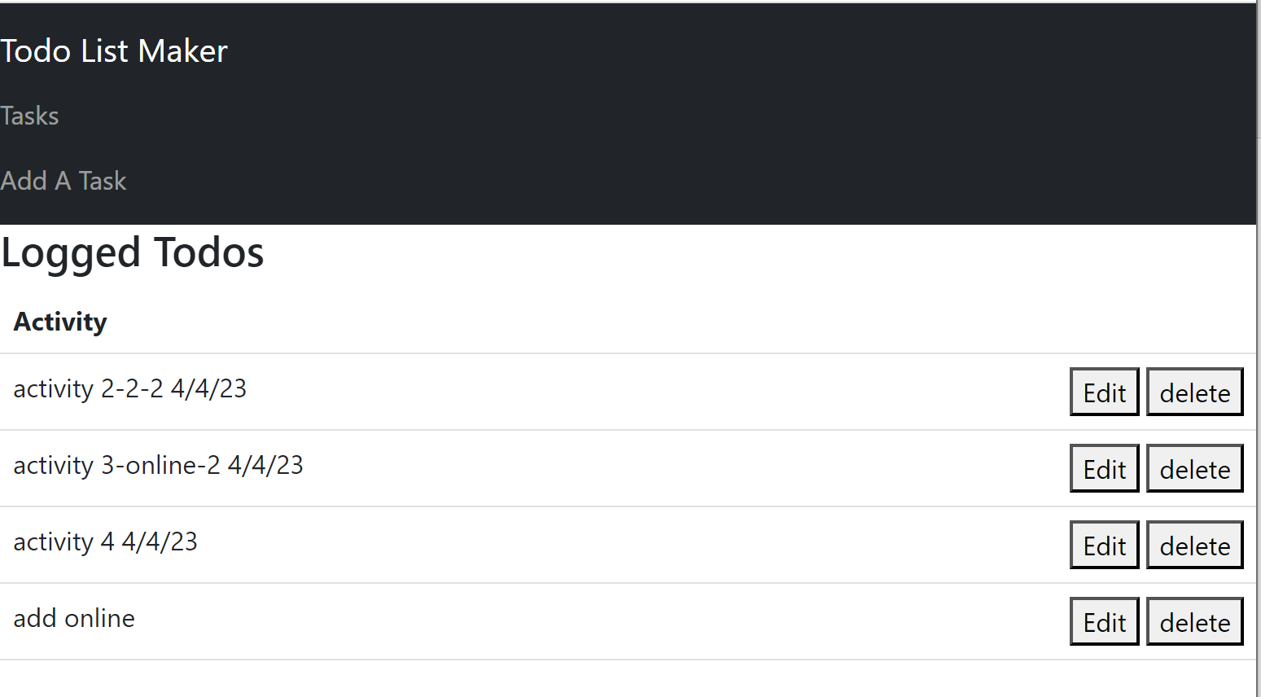
<Navbar />
state: {todos (key, activity)}
<SimpleTodoList />
f: {edit(id), delete(id)}
<Todo (props.key, props.todo, props.edit, props.delete ) />

